Slide 1

Learning infrastructure as code with Azure Bicep
with Elkhan Yusubov
Sept 29, 2022
Notes:
Before starting the session, I would like to
THANK YOU !!!
ORGANIZERS: shout-out to Gregory in making this event happen.
VIWEVERS: to ALL awesome people who is considering to watch and learn, and Extra shout-out to the once who connected with me on LinkedIn or Twitter!
MY FAMILY: to my wonderful wife and kids who made this possible by providing time to make this happen on off-work hours.
In this session, you will learn about What is new in Azure Bicep language.

Slide 2





Elkhan is a Cloud Architect Manager, Microsoft Azure MVP and 15+ MCT with experience in cloud solutions, enterprise healthcare systems and healthcare data, and API standards (HL7 FHIR, EDI X12).
He is an active Microsoft Tech Community Contributor, Cloud Lunch and Learn Speaker and Co-Organizer, and LinkedIn instructor with interests in Architecture, DevOps & Security.
He is a frequent speaker at tech meetups and has volunteered for Give Camps, Azure Data Fest, SQL Saturdays and Microsoft community events, like this one.
And please, checkout his blog posts at Cloud Marathoner site below.
Elkhan Yusubov
Speaker | Author | Influencer
Cloud Architect | Founder
@ElYusubov
https://linktr.ee/elyusubov
https://theCloudMarathoner.com ⛅🏃‍♂️🏃‍♀️
ElYusubov
Notes:
Information about myself is listed here, in short:
I have been MCT since 2007 and have been practicing Microsoft Azure in last 7 years.
I was nominated & awarded with Microsoft Azure MVP !
And I am very proud & honored for that recognition.
- I am a Founder of the #cloudmarathoner blog, which shares Cloud and Microsoft Azure learning resources and journey focused on hands-on automation skills and certification.
This blog encourage everyone to share useful tips and bits in their cloud journey & help the beginners to succeed.
In the #cloudcommunity, I am a core member of the CLL team and actively participate in the Cloud Family events .
OK, enough about myself, please share about yourselves, what you do and interested in, please type in comments … Thanks!

Slide 3
What we will cover
What is Azure Bicep
Bicep language benefits
Demos
Updates on Azure Bicep
Productivity Tips
https://theCloudMarathoner.com ⛅🏃‍♂️🏃‍♀️
Notes:
Let’s look into what we will cover today.
Well, we will start with ….
Official description of the session: What is new in Bicep language
We will start with what we traditionally had in Azure to provision resources.
Then how new DSL language – Bicep : get started evolving to help simplify Azure resource management.
Demos on Bicep!

Slide 4

What is Azure Bicep?
New DSL for managing Azure resources
Transparent abstraction over ARM
Clean way to author Azure resources
Connected with ARM Templates
https://theCloudMarathoner.com ⛅🏃‍♂️🏃‍♀️
Notes:
Main Point: Azure Bicep is a new DSL language that transpiles into ARM templates.
It’s purpose is to create simple, easy and intuitive language to author Azure infrastructure as code.
So, what is the Azure Bicep?
The new language aims to make it easier to write Infrastructure as Code (IaC) for developers and DevOps engineers that typically create ARM templates targeting Azure Resource Manager (ARM) APIs.

Slide 5
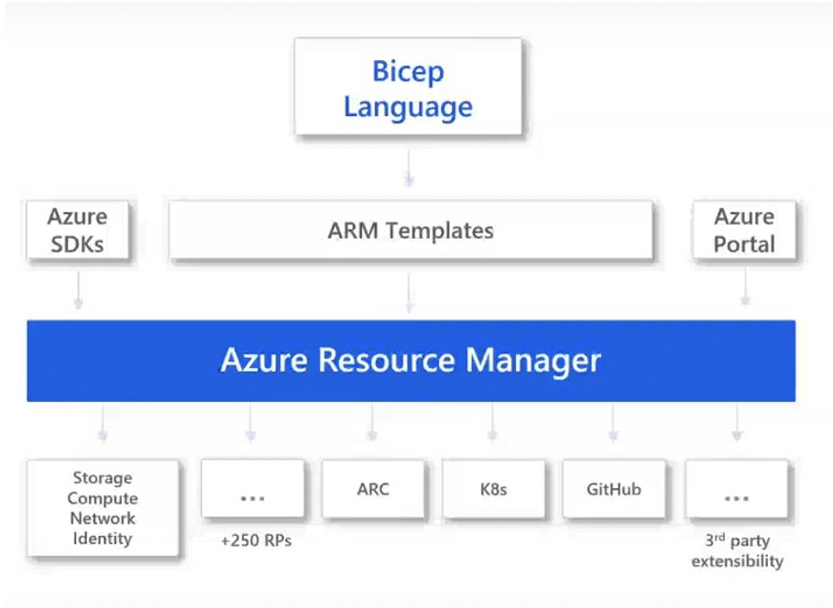
Bicep Language vs ARM templates
https://theCloudMarathoner.com ⛅🏃‍♂️🏃‍♀️
Notes:
Azure Bicep works as an abstraction layer built over the ARM layer and ARM Templates.
All resource types, API Versions, and properties valid in an ARM template are equally valid in Azure Bicep.
Anything that you can do with Azure ARM Templates is doable with Azure Bicep, as it provides a “transparent abstraction” over ARM (Azure Resource Manager).
So, the Azure ARM Templates is a templating engine where you declare resources using JSON, while Bicep language is the way to define Azure resources as a code.

Slide 6

Bicep language benefits
Easy to understand and maintain
Day Zero support
Transparent abstraction
Awesome tooling in VS Code
Clean code syntax
Code re-use and modularity
Deep integration with Azure
Preflight validation
No state management
Production support
https://theCloudMarathoner.com ⛅🏃‍♂️🏃‍♀️
Notes:
One of the most important questions is why? Why we need to switch learn Azure Bicep?
OK, I will give you 10 reasons to start with… I hope that will be convincing for a starter, right?
However,
Let’s look in VS Code to the modules\minimum-storage.bicep example & compare with its ARM JSON sibling ☺
Build JSON from bicep az bicep build --f .\modules\minimum-storage.bicep
Demo-2: Parametrize Azure Bicep file
Parametrize the file
Trick, create parameter file with default values, issue
Params created when no default values in file

Slide 7
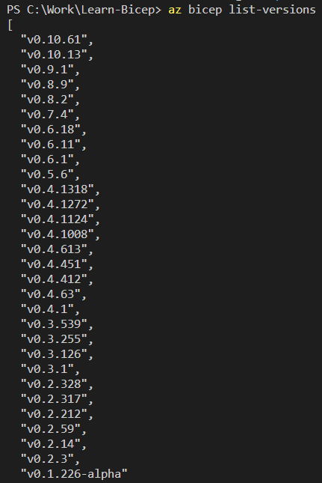
Azure Bicep evolution from 2020
Started as alpha version in 2020
Supported version: v0.3.1
Latest version: v0.10.61
Expected version v1.0 TBD ☺
https://theCloudMarathoner.com ⛅🏃‍♂️🏃‍♀️
Notes:
Started as alpha version in Aug 28, 2020
First supported version v0.3.1 - Mar 1, 2021
Modules > appservice.bicep
Demo-1: Azure Bicep getting ready CLI & runtime, build and compare with JSON
- az bicep build -f .\modules\appservice.bicep
Demo-2: Azure Bicep command line

Slide 8
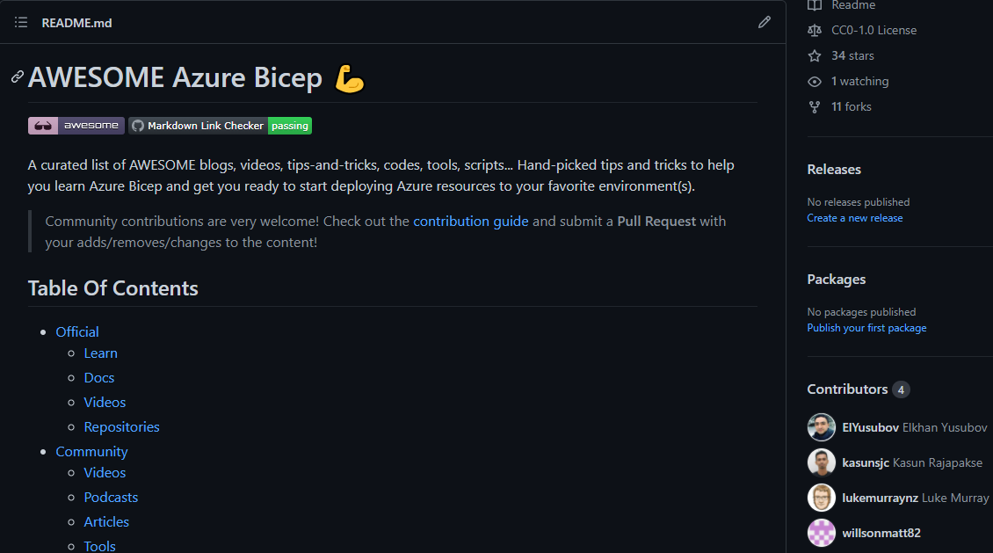

Bicep dev environment?
https://theCloudMarathoner.com ⛅🏃‍♂️🏃‍♀️
Notes:
Installation Link:
https://github.com/ElYusubov/AWESOME-Azure-Bicep
For Azure CLI, you need version 2.20.0 or later;
for Azure PowerShell, you need version 5.6.0 or later
Navigate to: Repo – describe
VS Code dev environment – demo
Demo-3: Build & deploy using right-click on Bicep file
Repeat another build and deploy with script.

Slide 9
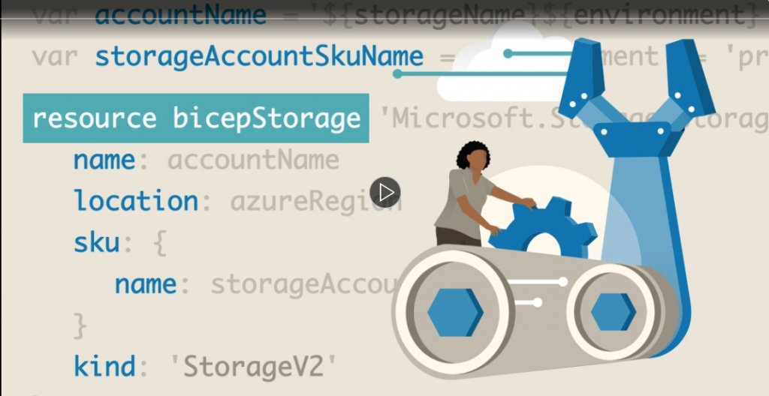
Azure Bicep First Look video course
www.TheCloudMarathoner.com ⛅🏃‍♂️
Notes:
Link: https://www.linkedin.com/learning/azure-bicep-first-look/learning-azure-bicep

Slide 10

VS Code & Bicep productivity tips
What is Bicep config file ?
Why you need one ?
How is analyzer organized ?
What are the default configurations ?
https://theCloudMarathoner.com ⛅🏃‍♂️🏃‍♀️
Notes:
Now, let’s look into VS code extension for Bicep language.
Highlight the config file and its function.
Demo 2: Deploying Parent/Child Azure resources AND Bicep config file
14-deply-child-parent
- Fix deploymentLocation, introduce a parameter
Go through options
Try first deployment with pre-flight check
Fix container name
Re-deploy

Slide 11

Updates in Azure Bicep
Bicep Public & Private Registry
Deploy a Bicep file from VS Code
Bicep Visualizer
Code snippets
Auto generated parameters in VS Code
https://theCloudMarathoner.com ⛅🏃‍♂️🏃‍♀️
Notes:
Azure/bicep-registry-modules

Slide 12
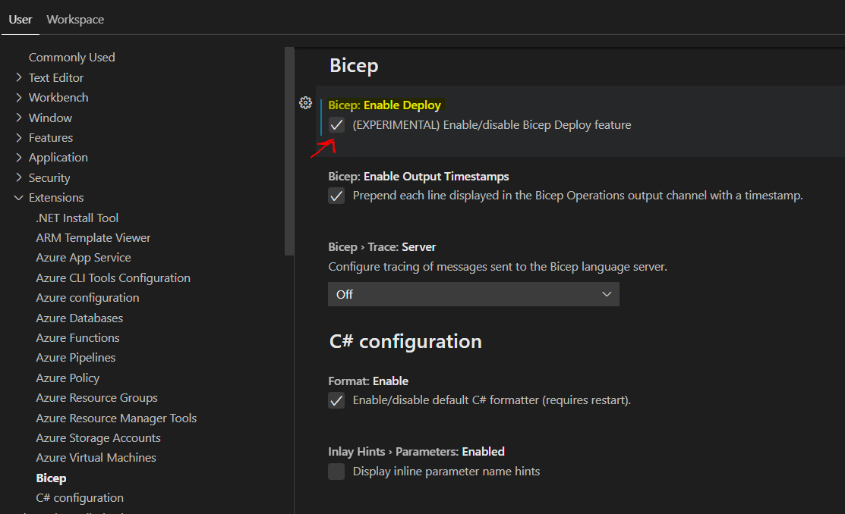
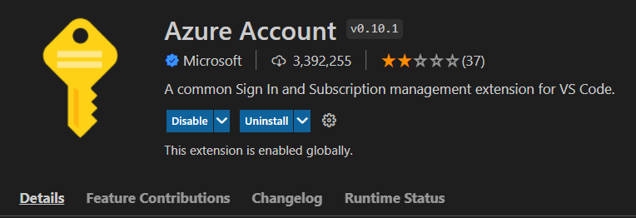
Deploy a Bicep file from VS Code
https://theCloudMarathoner.com ⛅🏃‍♂️🏃‍♀️
Notes:
Deploy with right-click
Enable from Settings
Setup Azure Account extension
modules/storage.bicep

Slide 13
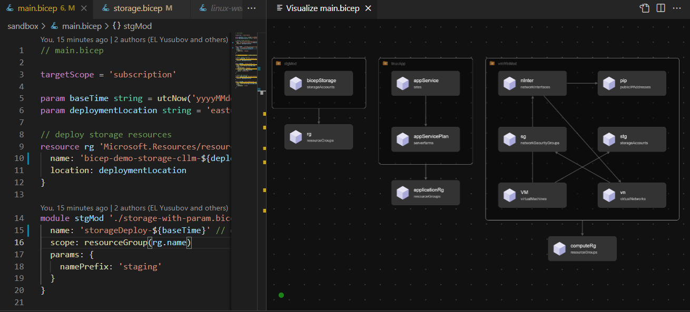
Bicep file visualizer
Visualized Bicep file resources
https://theCloudMarathoner.com ⛅🏃‍♂️🏃‍♀️
Notes:
Showcase a complex deployment from 7-deploy-modules-w-param.bicep
Highlight the modules
Storage account declaration with a lock
- Point out to visualizer

Slide 14
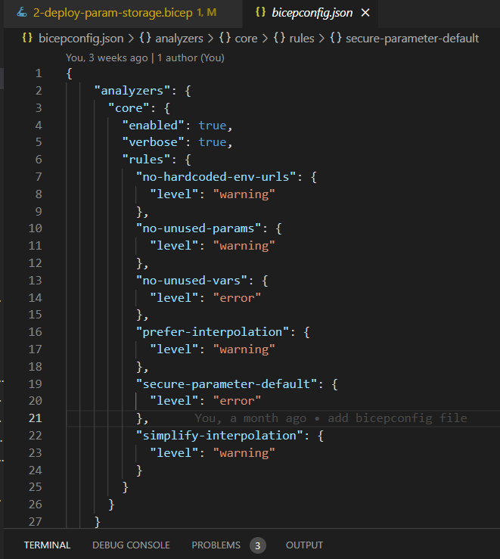
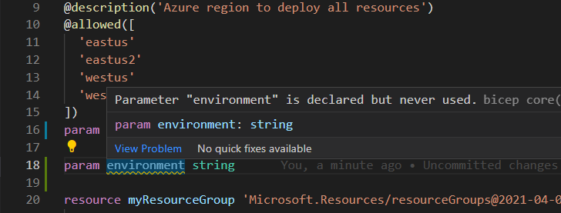
Demos
https://theCloudMarathoner.com ⛅🏃‍♂️🏃‍♀️
Notes:
Demo 5: Hardening parameters of deployment, the Bicep config and #disable-next line
Check the 1-deploy-rg.bicep
Demo: Bicep Insert resource
Check the “modules/ appservice.bicep” – Bicep Insert resource
View -> Command Plata -> Bicep Insert resource
App insights name: docker-test-suit
Get the resource Id in Azure ?

Slide 15
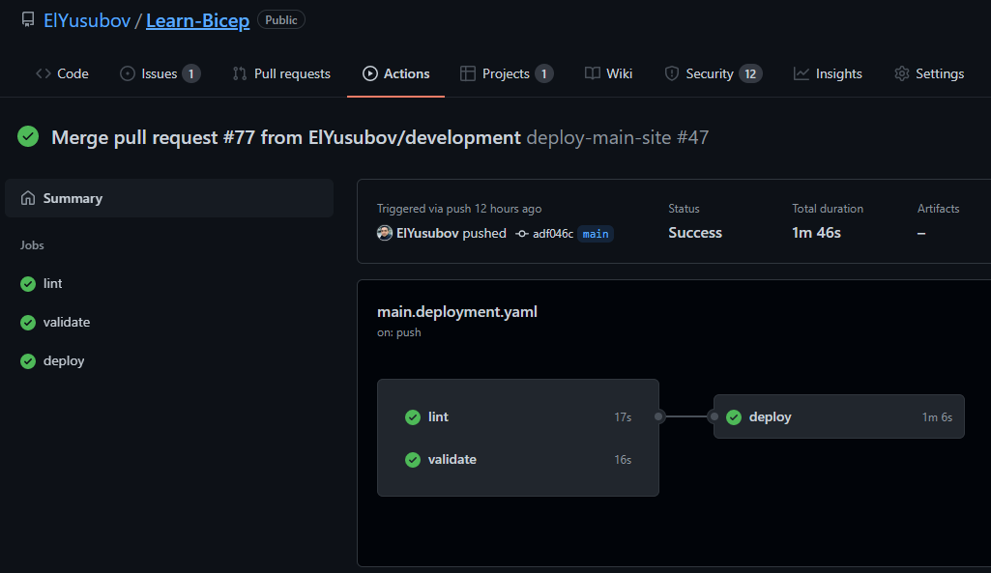
Automating with GitHub workflow
https://theCloudMarathoner.com ⛅🏃‍♂️🏃‍♀️
Notes:
Demo 6: Deploying Azure Bicep resources with GitHub Actions: deploy > main.bicep
Parametrization and validations
Environment configuration map
Setting App service and App insights infrastructure

Slide 16

Notes:
Please, type in chat – what would you like to learn in Azure Bicep ?
What is the interesting Azure Bicep topic you want to learn about?

Slide 17
What we have covered
What is Azure Bicep
Bicep language benefits
Demos
Updates on Azure Bicep
Productivity Tips
https://theCloudMarathoner.com ⛅🏃‍♂️🏃‍♀️
Notes:
Let’s look into what we will cover today.
Well, we will start with ….
Official description of the session: What is new in Azure Bicep language?
We will start with what we traditionally had in Azure to provision resources.
Then how new DSL language – Bicep : get started evolving to help simplify Azure resource management.
Demos on Bicep!

Slide 18




What is next?
Learn Bicep – GitHub
Azure Bicep – First Look course 📽
Bicep Project - GitHub
AWESOME Azure Bicep 💪 - GitHub
Notes:
Pinned to repos - advert Learn-Bicep
Advert "AWESOME Azure Bicep" as a great learning companion
Shameless plug - please like it, STAR & Fork it - make PRs with your suggestions

Slide 19
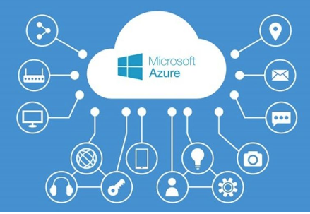
https://linktr.ee/elyusubov
Thank you !
Elkhan Yusubov
Speaker | Author | Cloud Architect
Founder at #cloudmarathoner
www.meetup.com/azure-dominicana
www.theCloudMarathoner.com ⛅🏃‍♂️🏃‍♀️
Notes:
Thank you

